Slide 1
Lecture 4 Shape and Graphs of Distributions

Slide 2
Review
1 What is a distribution?
The values a variable takes and how often each one occurs.
2 What are the three features we look for in a distribution?
Shape, center, and variability.
3 Which feature do we describe for a categorical variable?
The modal category – the category with the highest frequency.
4 What is a frequency table?
A table of the distinct values of a variable together with the number of observations of each value.
5 Why can't we build a frequency table for a continuous variable directly?
There are too many distinct values – almost every observation is unique. We bin first.

Slide 3
Review
1 How do we bin a continuous variable?
Divide the range into K non-overlapping intervals of equal width, then count how many fall in each.
2 Which graphs do we use for a qualitative variable?
Bar graphs, pie charts, and Pareto charts.
3 Which graphs do we use for a quantitative variable?
Dot plots, stem and leaf plots, and histograms – today's topic.
4 Why graph the data when we already have the frequency table?
The graph shows shape, center, and spread at a glance, along with any outliers.

Slide 4
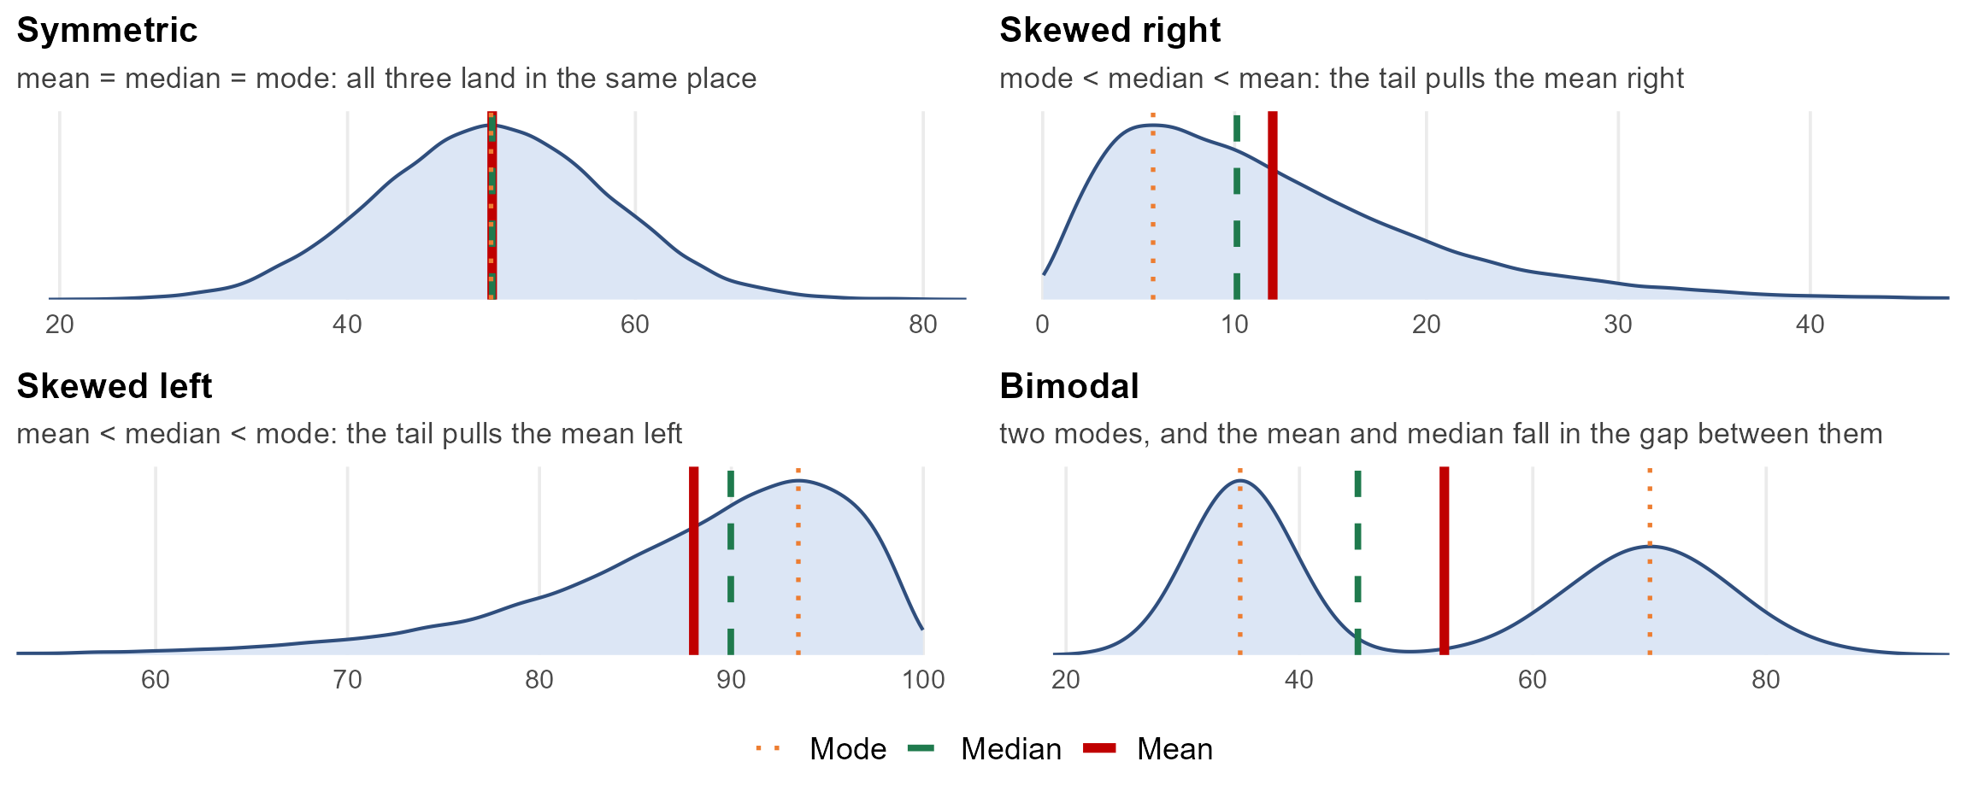
Shape of a distribution
Mean – the balancing point of the data. Add up every observation and divide by how many there are.
Median – the middle value. Half of the observations fall below it and half fall above.
Mode – the most common value, which is the peak of the distribution.

Slide 5
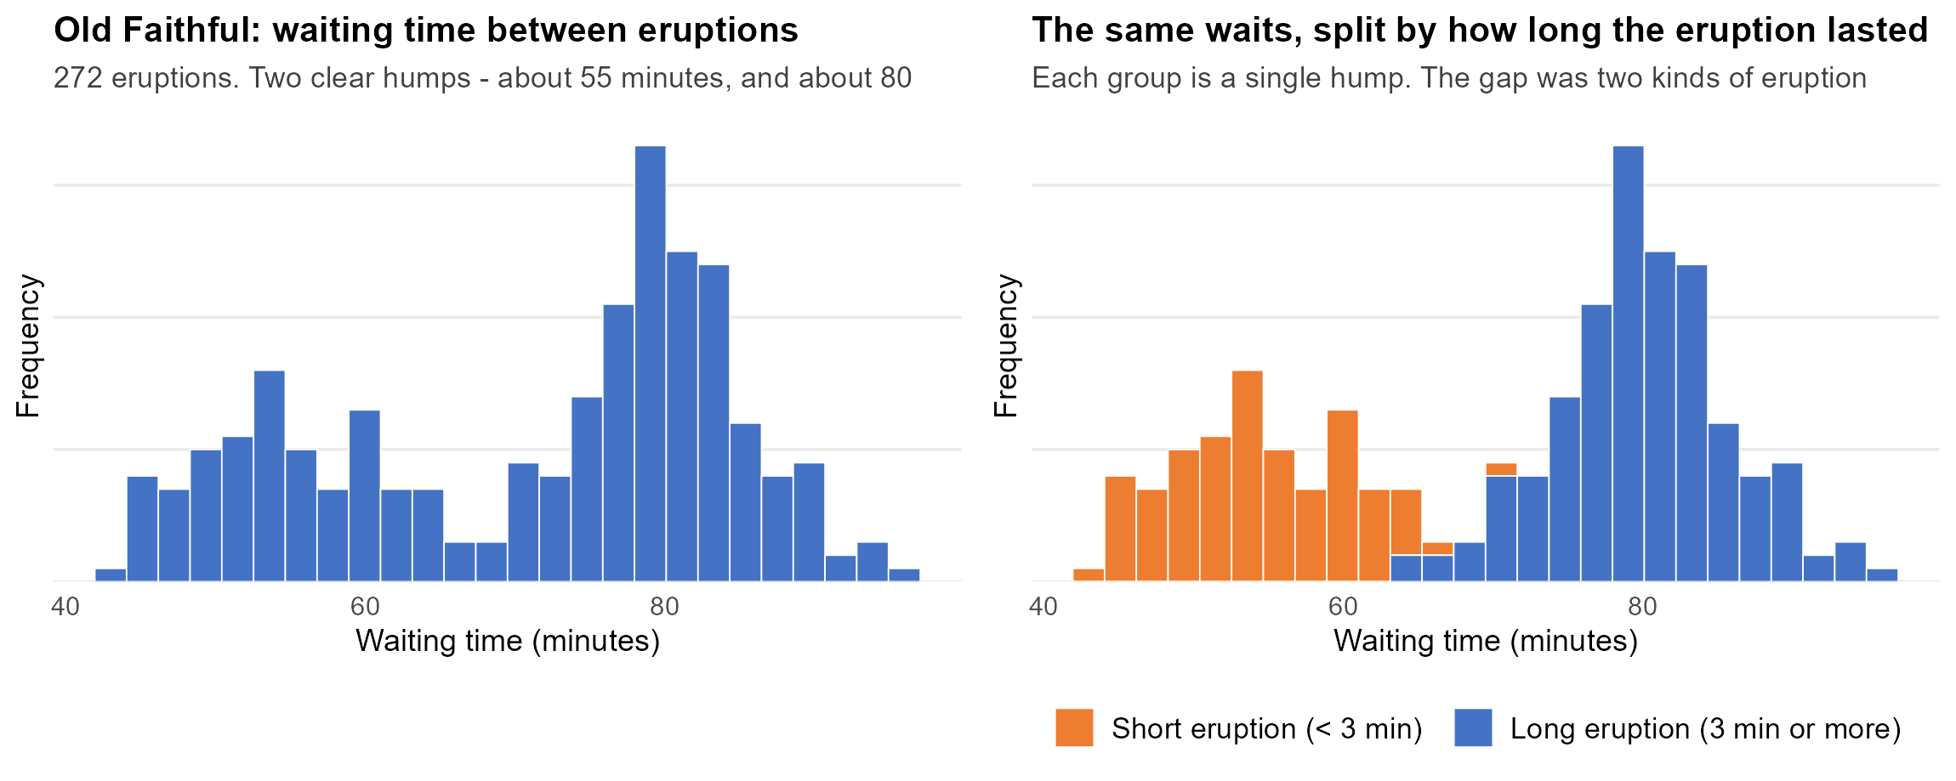
Bimodality: Old Faithful
Two peaks are a signal that the sample mixes two different kinds of thing. Here, two kinds of eruption.

Slide 6
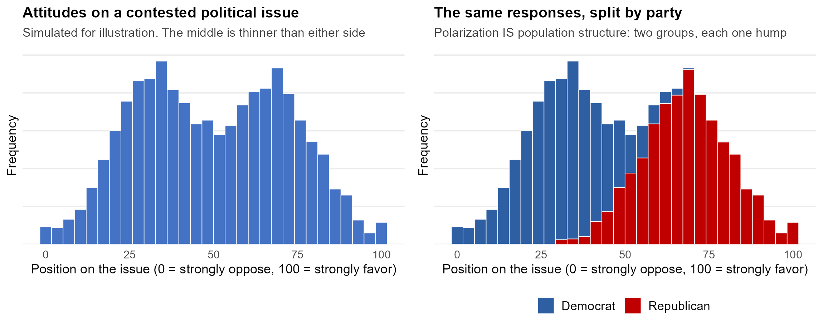
Bimodality: a polarized public
A population polarized on an issue IS two sub-populations. Here the grouping variable is party.
Left panel is simulated for illustration, not survey data. To read more on how Americans actually group politically: Pew Research Center, "Beyond Red vs. Blue: The Political Typology" (June 10, 2026). https://www.pewresearch.org/politics/2026/06/10/beyond-red-vs-blue-the-political-typology/

Slide 7
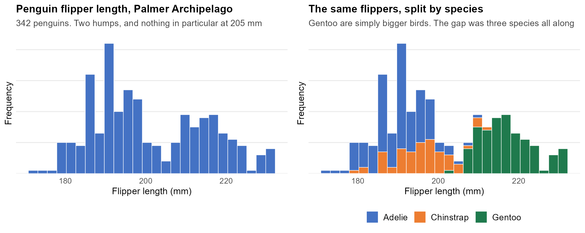
Bimodality: penguin species
Here the grouping variable was recorded, so we can check the claim instead of just arguing it.
Palmer Archipelago penguin data: Gorman KB, Williams TD, Fraser WR (2014), PLoS ONE 9(3):e90081, via the palmerpenguins R package. 342 birds with flipper measurements.

Slide 8
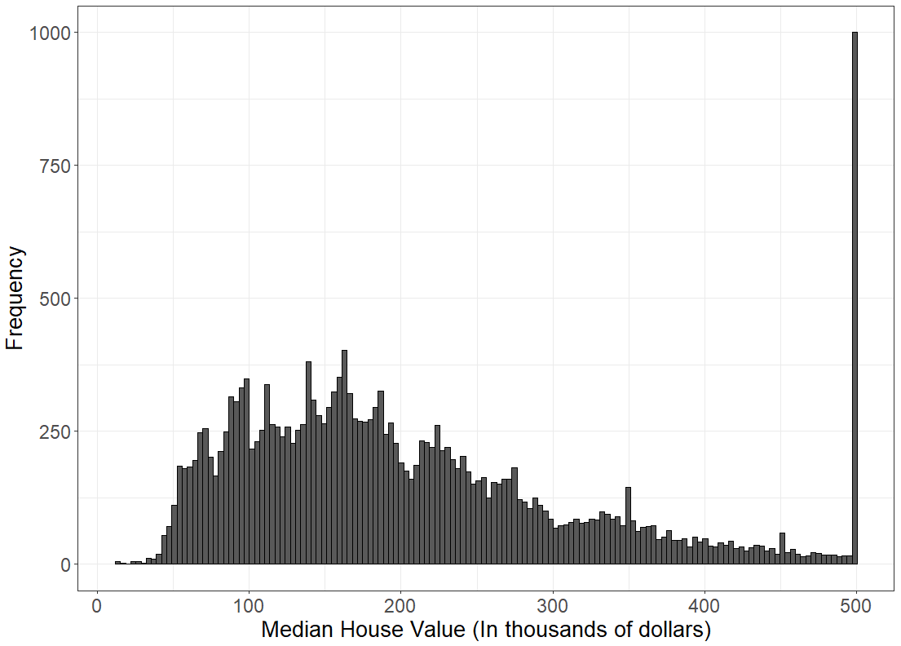
Skew: a hard limit on the values
Skew appears when there is a hard limit on the values a variable can take
Values pile up against the limit and trail away from it
Prices and incomes cannot go below zero
The age of adults cannot go below 18
Exam scores cannot go above 100
The long tail drags the mean toward it, so the mean and median disagree

Slide 9
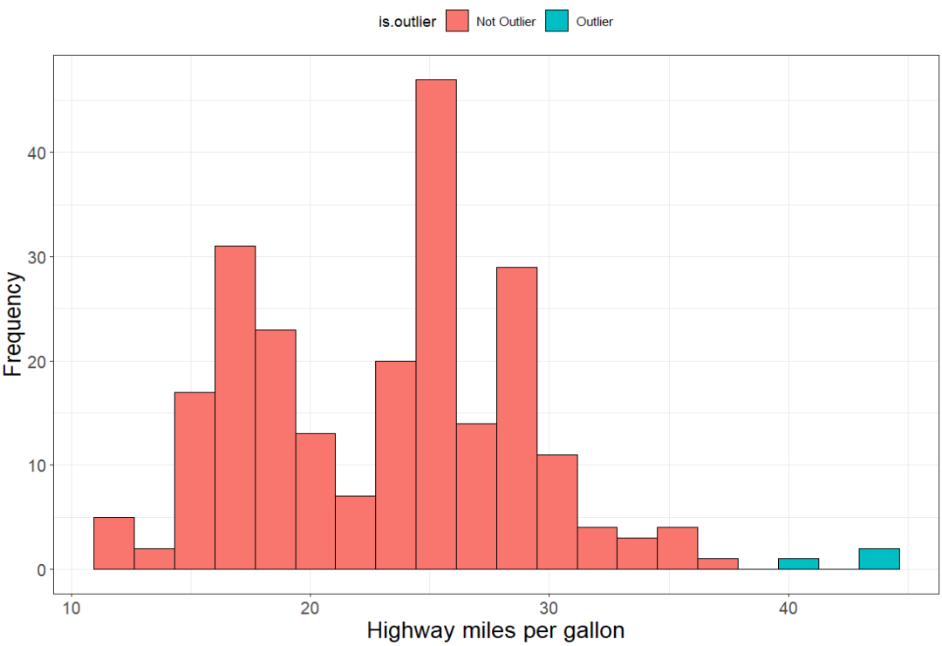
Outliers: a real value, or a mistake
An outlier is an extreme value lying far away from the rest of the data
Two very different causes:
a real observation that genuinely is unusual
a measurement or recording error
The plot cannot tell you which. Go back to the source and check
Either way an outlier pulls the mean hard, so find them first

Slide 10
Visualizing Distributions: Quantitative Variables
Dot plots – shows a dot for each observation placed above the value for that observation
Steps to construct a dot plot
Draw a horizontal line and mark the line with regular values of the variable
For each observation, place a dot above its value on the number line
Works best with quantitative discrete data
Doesn’t work well if the variable is continuous and takes on many distinct values…
For continuous data, the values may need to be round to the nearest tenth or integer

Slide 11
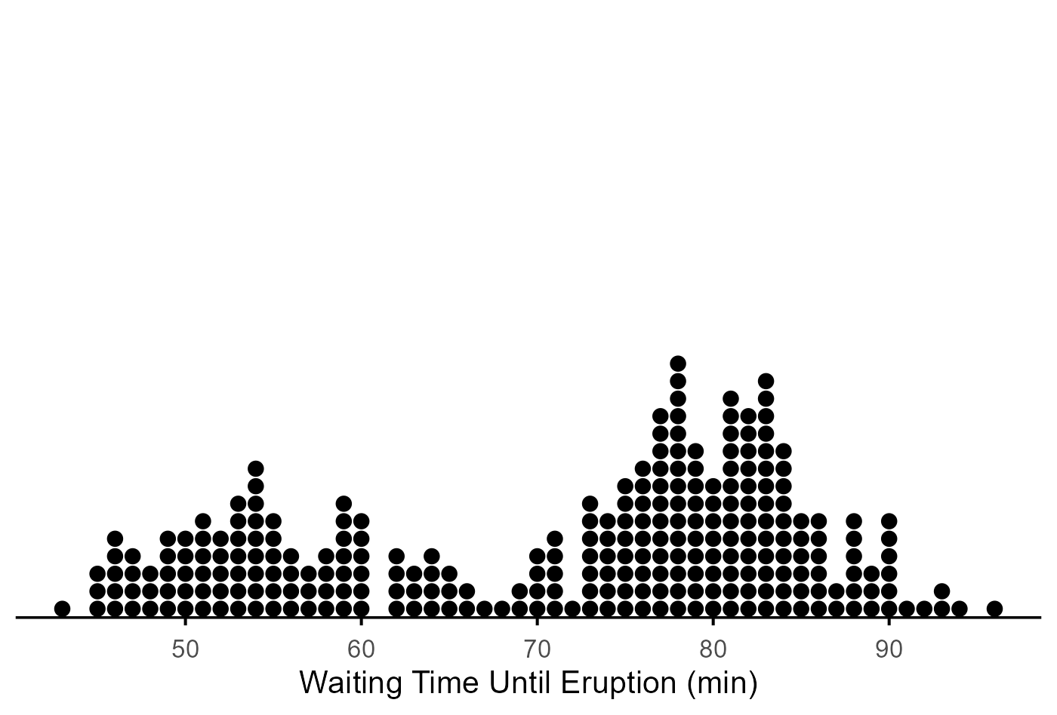
Dot plot of Old Faithful waiting times

Slide 12
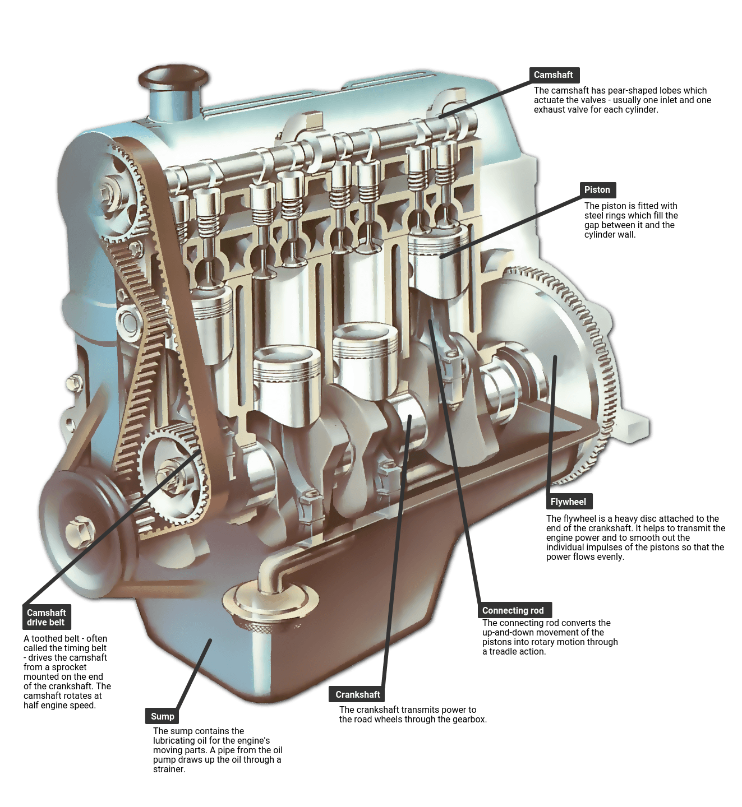
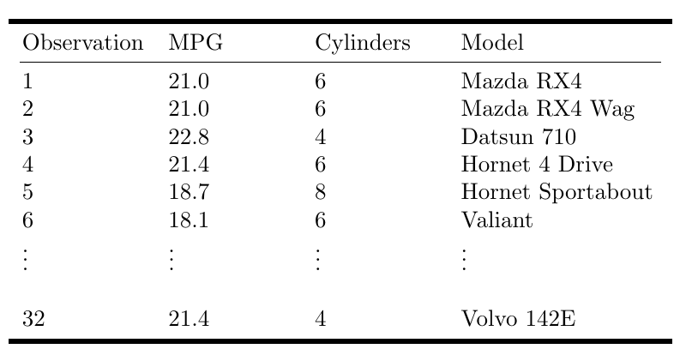
Example: MPG and Engine Cylinders
About the data: mtcars – road-test figures for 32 cars from the 1974 Motor Trend US magazine (1973–74 models), one row per car. We use two of its 11 variables: mpg (miles per US gallon, ranging 10.4 to 33.9) and cyl, the number of engine cylinders – 4, 6 or 8, with 11, 7 and 14 cars in each group. Cylinder count is a grouping variable, which is what lets the dot plot on the next slide compare three groups side by side.

Slide 13
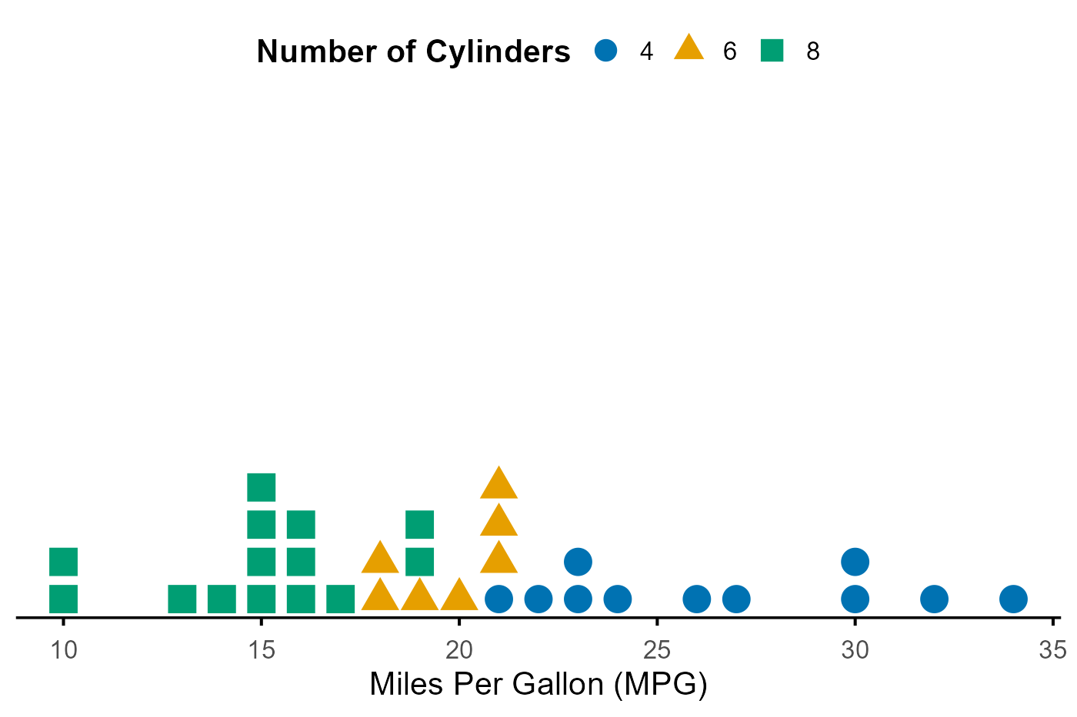
Dot plot of miles per gallon by cylinder count

Slide 14
Dot plot: strengths and weaknesses
Strengths
Shows every individual observation, so nothing is hidden or summarized away
Quick to draw by hand, and easy for a reader to check against the data
Good for small samples and for comparing a few groups side by side
Weaknesses
Becomes an unreadable smear once n is large or values repeat heavily
Needs rounding for continuous data, which throws away precision
Cannot be smoothed the way a histogram can with wider bins

Slide 15
Visualizing Distributions: Quantitative Variables
Stem and leaf plot – like a dot plot, a stem and leaf diagram also displays individual observations.
Stem – all the digits in an observation except the last digit
Leaf – the last digit in an observation
Steps to construct a stem and leaf plot
Sort the data in order from smallest to largest.
Place the stems in a column in increasing order
Place a vertical line to the right of the stems
To the right of the vertical line, fill in the leaves that correspond with each stem in increasing order
82
Stems
Leaves
8 2

Slide 16
Example: MPG

Slide 17
Try it out: Stem and leaf plot
Data = 4.2, 3.8, 4.6, 3.2, 2.7, 8.2, 9.1, 0.2, 1.2, 6.2

Slide 18
Stem and leaf plot: strengths and weaknesses
Strengths
Keeps the actual data values, so the original observations can be read back off the plot
Shows the shape and the digits at the same time
Works well for moderate samples, roughly n of 15 to 50
Weaknesses
Awkward for large n: the leaves run off the page
A poor fit for decimals, or for values spanning many orders of magnitude
The shape depends on which digit you choose as the stem

Slide 19
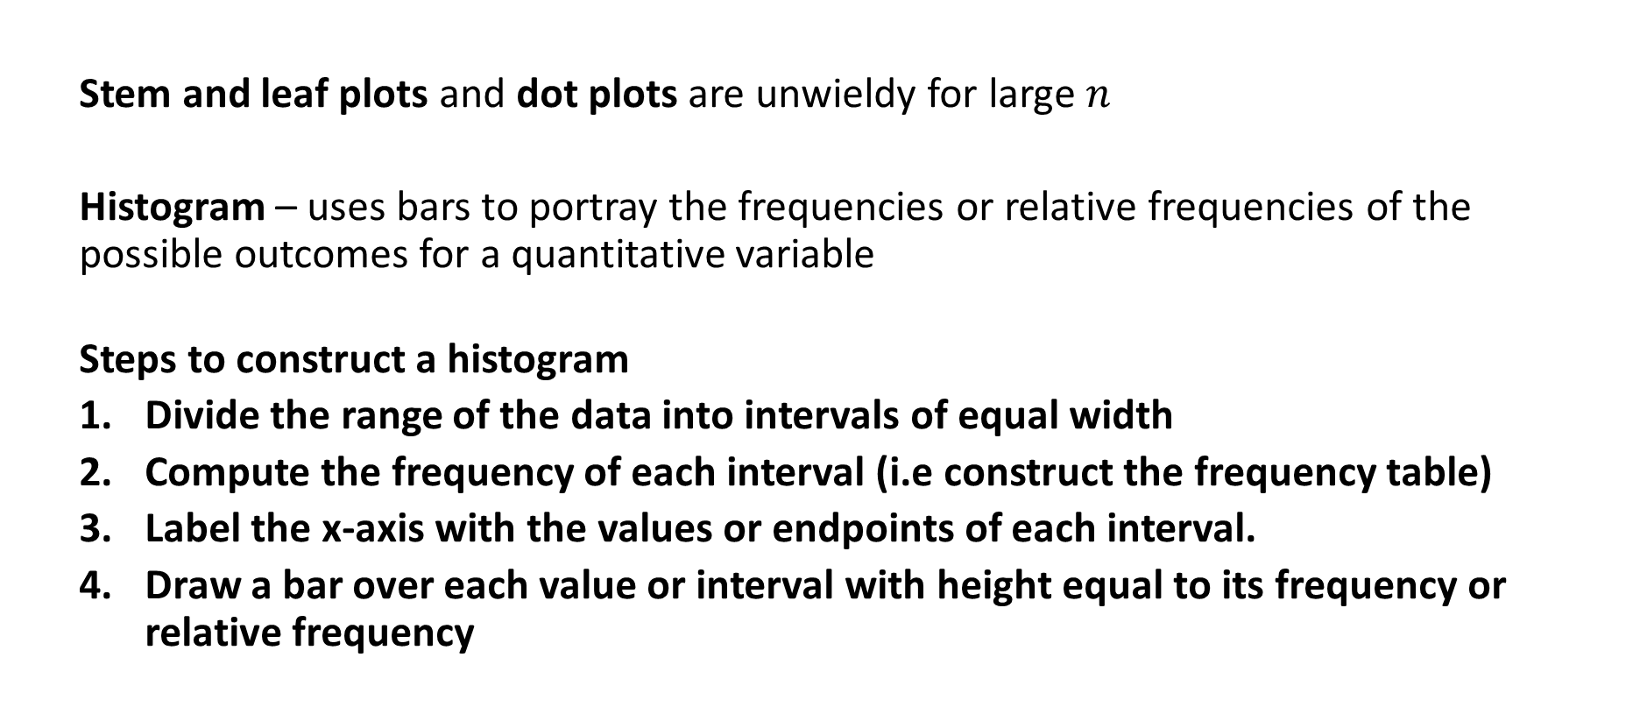
Visualizing Distributions: Quantitative Variables
Stem and leaf plots and dot plots are unwieldy for large $n$
Histogram – uses bars to portray the frequencies or relative frequencies of the possible outcomes for a quantitative variable
Steps to construct a histogram
Divide the range of the data into intervals of equal width
Compute the frequency of each interval (i.e construct the frequency table)
Label the x-axis with the values or endpoints of each interval.
Draw a bar over each value or interval with height equal to its frequency or relative frequency

Slide 20
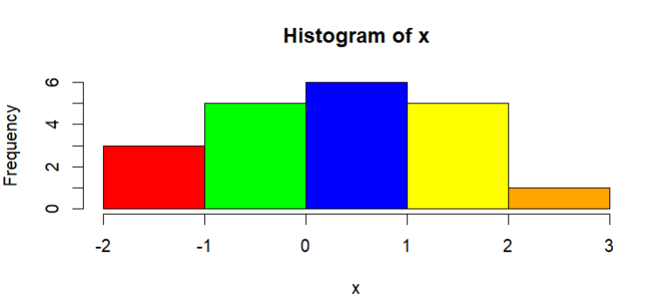
Try it out: Histogram
Consider the following $n=20$ observations of a continuous variable
Bin 1
Bin 2
Bin 3
Bin 4
Bin 5
x = -1.5, -1.2, -1.0, -0.8, -0.7, -0.6, -0.1, -0.1, 0.1, 0.1, 0.1, 0.6, 0.6, 0.8, 1.1, 1.2, 1.3, 1.8, 1.9, 2.4

Slide 21
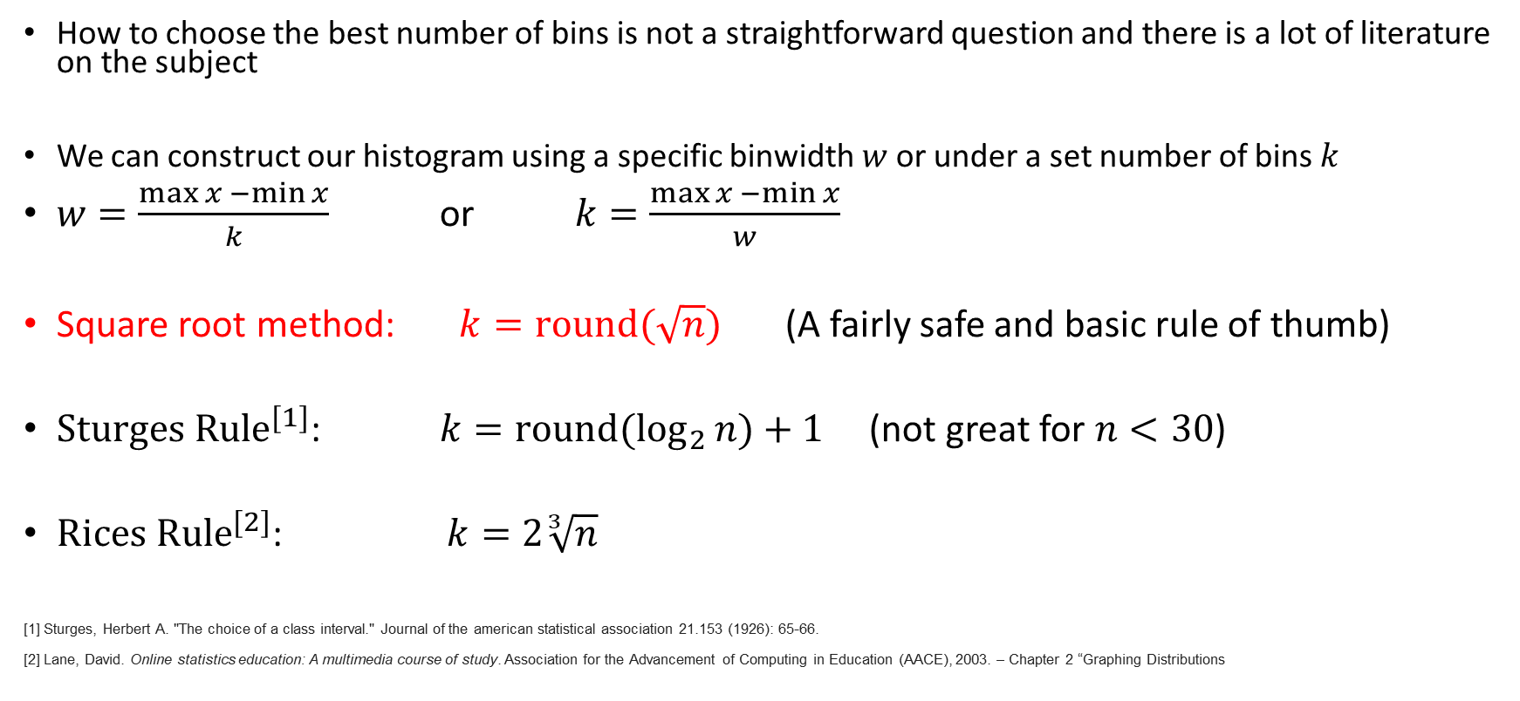
How to choose the number of Bins?
How to choose the best number of bins is not a straightforward question and there is a lot of literature on the subject
We can construct our histogram using a specific binwidth $w$ or under a set number of bins $k$
$w=\frac{\max{x −\min{x}}}{k}$ or $k=\frac{\max{x −\min{x}}}{w}$
Square root method: $k=round(\sqrt{n})$ (A fairly safe and basic rule of thumb)
${Sturges Rule}^{[1]}$: $k={round(log}_{2}{n)+1 }$ (not great for $n<30$)
${Rices Rule}^{[2]}$: $k=2\sqrt[3]{n}$
[1] Sturges, Herbert A. "The choice of a class interval." Journal of the american statistical association 21.153 (1926): 65-66.
[2] Lane, David. Online statistics education: A multimedia course of study. Association for the Advancement of Computing in Education (AACE), 2003. – Chapter 2 “Graphing Distributions

Slide 22
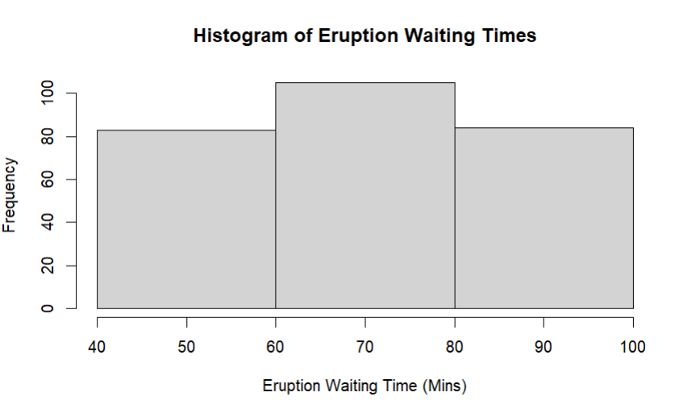
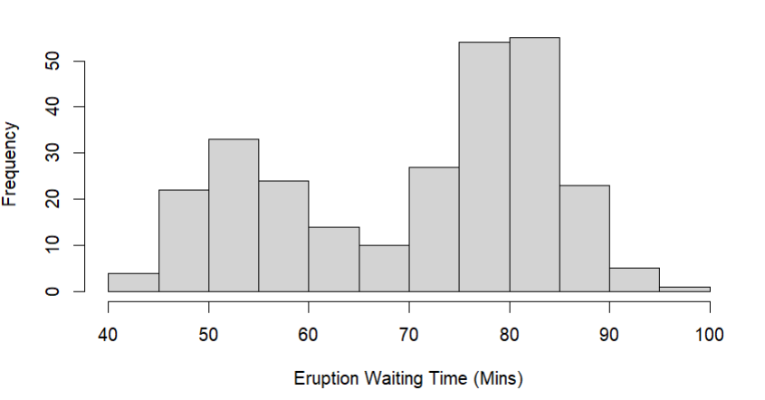
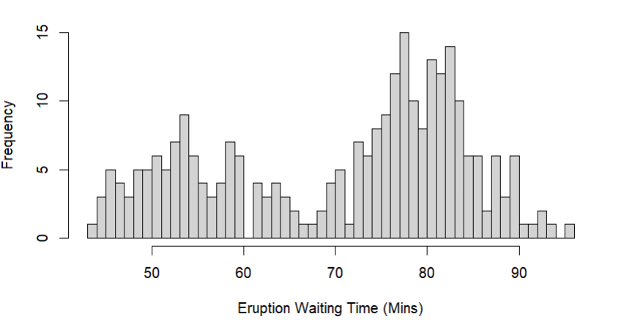
Some tips
If too few intervals are used, then the graph will be too crude
If too many intervals are used, graph will contain many short bars and gaps.
Usually between 5 - 15 intervals are enough.
Most plotting software will automatically choose the number of bins.
ALWAYS plot the histogram to get an idea about the shape of the distribution of a quantitative variable
Is the number of observations is small (say n < 50) then it’s a good idea to supplement a histogram with a dot plot or stem plot

Slide 23
Histogram: strengths and weaknesses
Strengths
A great way to get an idea of shape when the sample is medium or large (n > 20)
Handles continuous data at any sample size, and stays readable as n grows
The standard choice for showing a distribution to someone else
Weaknesses
Hides the individual observations: you see bars, not data points
The shape depends on the number of bins, so it can distort shape for small samples
Bin edges are arbitrary, and moving them can change the story the picture tells

Slide 24
From pictures to numbers
Next: measures of location and position. Single numbers that say where a distribution sits.
Numbers can be computed with. A graph is read by eye. A statistic goes into a table, a comparison, or a hypothesis test.
"What is a typical value?" The first question anyone asks of a dataset, and the mean, median and mode each answer it differently.
Comparing groups. Two samples are compared through their centers, not by squinting at two histograms.
Where does one observation sit? A score of 78 means little until you know it falls at the 90th percentile.
Shape decides which measure to trust. Skew and outliers drag the mean but leave the median alone, which is why we did shape first.

Slide 25
Measures of Central Tendency
The (arithmetic) mean is the average value of a set of observations
it measures the center of mass of a distribution (the balancing point)
$\overline{x}= \frac{x_{1}+x_{2}+…+x_{n}}{n}= \sum_{i=1}^{n}{\frac{x_{i}}{n}}$
the mean is usually not equal to any of the values observed in the sample
The mean is highly influenced by outliers - observations that take on extreme values relative to the distribution

Slide 26
Practice: Calculate The Mean
$X=\{1, 3, 5, 5, 6, 7, 7, 8\}$

Slide 27
Measures of Central Tendency
The median is the middle value of a set of observations
How to compute the median:
Compute the median by first ordering the observations from smallest value to largest value and choose the number in the middle
If the $n$ is odd the median is the middle number
- If $n$ is even the median is the sum of the two middle values divided by 2

Slide 28
Practice: Calculate the Median
$X=\{1, 3, 5, 5, 6, 7, 7, 8\}$

Slide 29
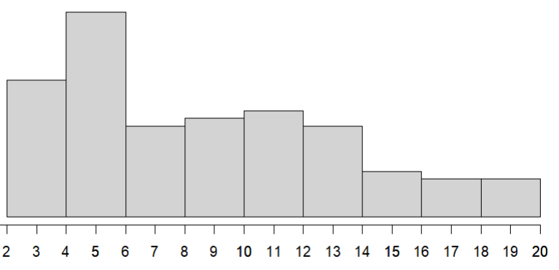
Data: 3 3 3 3 3 3 3 4 4 4 4 4 4 4 4 4 4 5 5 5 5 5 5 5 5 5 5
5 5 5 5 5 5 5 5 5 6 6 6 6 6 6 6 6 6 6 7 7 7 7 7 7 7 7
7 8 8 8 8 8 8 9 9 9 9 9 9 9 10 10 10 10 10 10 10 11 11 11 11 11 12
12 12 12 12 12 12 12 13 13 13 14 14 14 14 14 14 15 15 15 16 16 16 16 17 17 17 18
18 20 20 20 20 20
$$\overline{x}=9.2$$
$$median=\frac{8+8}{2}=8$$
The mean is the center of gravity
The median is the middle value

Slide 30
Mean and median treat outliers differently
$X=\{1, 3, 5, 5, 6, 7, 7, 8, 32\}$

Slide 31
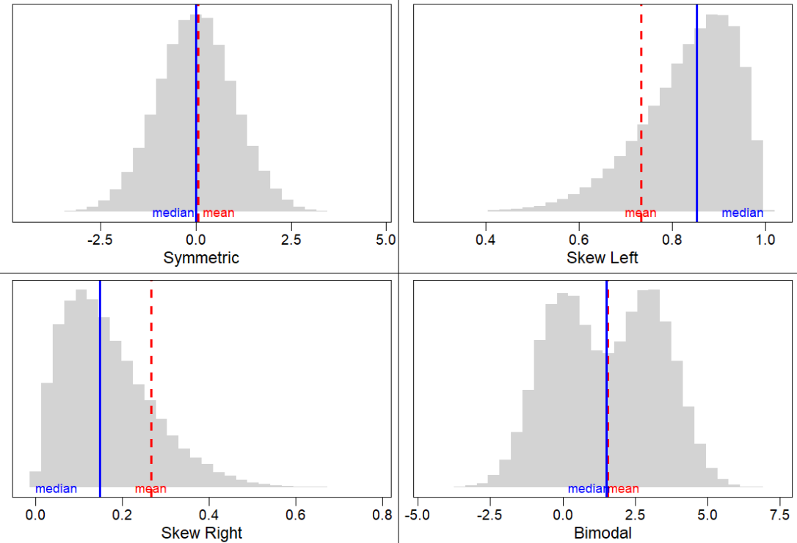

Slide 32
Alternative formulas for the mean
We can also express the mean in terms of the frequency $F$ or the relative frequency $RF$
$$\overline{x}=\frac{1}{n}\sum_{x}{x F(x)} or \overline{x}=\sum_{x}{x RF(x)}$$
Where the sum is over all distinct values of the variable $x$

Slide 33
Example: Computing the mean from a frequency table
X | Freq. | Rel. Freq
1 | 1 | 0.125
3 | 1 | 0.125
5 | 2 | 0.250
6 | 1 | 0.125
7 | 2 | 0.250
8 | 1 | 0.125
$$X=\{1, 3, 5, 5, 6, 7, 7, 8\}$$

Slide 34
The mode
The mode is the value with the largest relative frequency (i.e the value that occurs most often)
Can be used with categorical data (mean and median cannot)
- e.g the most frequent category
It may not be unique if two or more values have the same frequency
Caution for quantitative data, the mode may not anywhere near the center of the distribution.
Ex.)
Data = 1,1,4,5,6
Mode = 1
Data = 1,1,4,5,6,6
Mode 1, 6

Slide 35
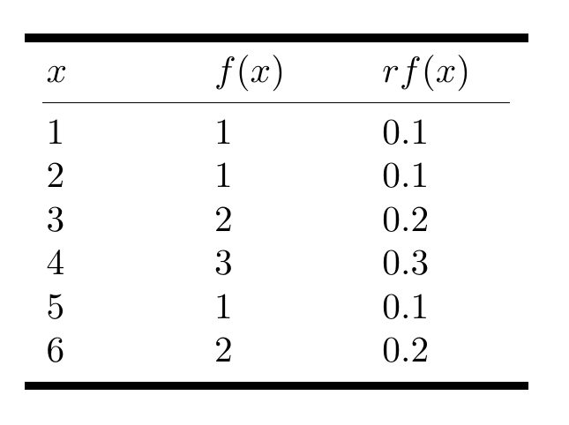
Practice:
Roll a six-sided die $n=10$ times and record the number rolled each time
Data = 1,2,3,3,4,4,4,5,6,6
Compute the mean using all 3 equations:
Compute the median
Compute the mode

